Slide 1

Automatic Cell Counting 4/11/2021
Team name: Cell Counting Group
Team members:
Jorge Tapias Gomez: Product Owner
Sriram Ramesh: Initial Scrum Master
Aaron Swoiskin: Developer
Dhruv Tummala: Developer
Notes:
Jorge

Slide 2
Automatic Cell Counting
The problem:
Lab researchers have to spend many hours of their time manually counting cells in samples that they obtain. This takes away time from their more important research and employers must pay for the time that they spend counting. This task is also heavily error-prone.
Notes:
Jorge

Slide 3
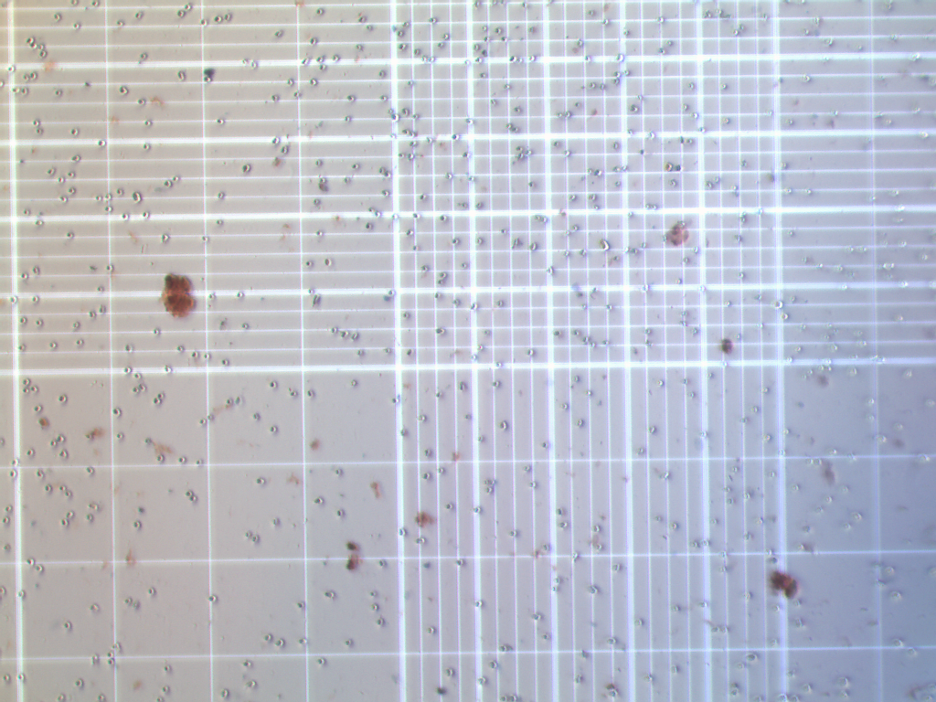
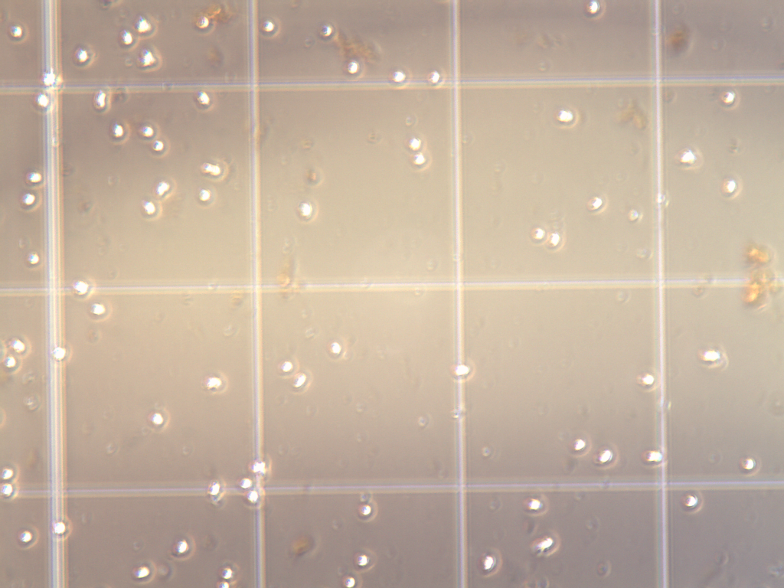
Project Scope
High level goals:
Be able to count cells correctly (ignore dirt specks)
Be able to identify dead cells
Be able to only count cells in a certain area
Have a simple interface that the user can interact with
Notes:
Sriram

Slide 4
Sprint 1
User stories
(21) As a lab researcher, I want to be able to not have to manually count the cells so that I can use my time for something else.
(8) As a lab researcher, I want to have a nice easy to use UI so that I don't get lost and can learn it easily.
Spikes |  | Infrastructure
Research and take notes on U-Net and R-CNNs following the template | Speak with lab researchers | Set up Github, Google team drive, Discord server
Learn proper data augmentation practices | Lookup online datasets of cell images | Set up Google Collab
Learn proper model training practices | Learn how to use our APIs | Set up trello and other scrum tools
Annotate our data | Research and determine an appropriate database | Store our training dataset in some database Augment, store, and categorize our data instances
Notes:
Dhruv

Slide 5
Sprint 2
User stories
(5) As a lab researcher, I don’t want to count specks of dirt or other visual clutter.
(3) As a lab researcher, I want to be able to save previous images and the data I got from them so that I can look at them later and not have to spend the time to redo past results.
(21) As a tester (or maybe even a lab researcher) I want to know what instances the tool is identifying as a cell so that I can verify that it is functioning properly. (Might get bumped down into sprint 3 if not implemented in sprint 2)
Spikes
Differentiation of living/dead cells, debris, etc.
Notes:
Jorge

Slide 6
Sprint 3
User stories
(5) As a lab researcher, I want to not have to manually identify dead cells so that I can use my time for something else.
(2) As a lab researcher I might want to know what percent of the dish are dead versus alive or cells vs non cells so that I can gain more information about the images I took.
(21) As a lab researcher, I want the tool to only count certain areas of the petri dish so that I can calculate whatever it is I need.
Spikes
Learning how to identify certain areas of the image and counting the cells in only those
Notes:
Aaron

Slide 7
Sprint 4
User stories
(3) As a lab researcher I want to know how to use the product without much outside help so that other people in the lab can spend more time doing other work instead of teaching others how to use the tool.
(13) As a lab researcher I want to know the average size of the cells so that I can have more information on the data.
(5) As a lab researcher I want the product to be easily found (and installed?) so that I can get started with it as soon as possible.
Spikes
Learning how to count size/calibrate
Might have to learn how to distribute the tool
Notes:
Sriram
Might have to learn how to distribute the tool depending on how we decide to distribute it

Slide 8



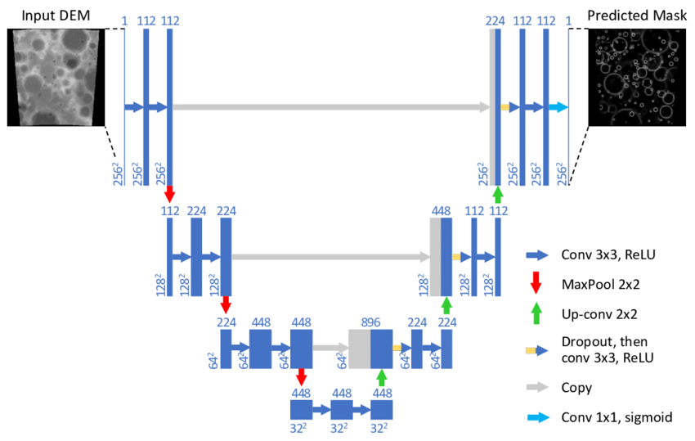
Architecture
UI
Number of cells
Notes:
Sriram

Slide 9




Technologies
Languages: Python
Keras from Tensorflow
tkinter
Cloud computing: Nautilus, Google collab
Database: SQL
Notes:
Dhruv
Mention sql database tbd

Slide 10
Challenges/Risks
Learning ML to solve this problem since we do not have experience
Learning what the Lab Researchers require from us
Collecting, Annotating, Manipulating, Augmenting data
Notes:
Aaron

Slide 11
Minimum Viable Product (MVP)
A tool that can accurately count the number of cells in an image that the tool has never encountered before.
Notes:
Aaron

Slide 12
Thank You
Any questions?

